Slide 1


Department of Collegiate and Technical Education
Understanding the concept of AGV in different industrial sectors (Week- 10)
Session 1
Automation & Robotics( V Semester)
Electronics and Communication Engineering
Electronics and Communication Engineering – 20EC53I

Slide 2

Table of Content
Introduction
Types of AGVs
Electronics and Communication Engineering – 20EC53I

Slide 3
Introduction to Automated Guided Vehicle
An Automated Guided Vehicle is an automated material handling system which moves along predefined or preprogram path along an aisle from one station to another to MH operation.
Most AGV are driven by electric motors powered by storage battery.
Good for high labor cost, hazardous, or environmentally sensitive conditions.
AGVs good for low-to-medium volume medium-to-long distance random material flow operations (e.g., transport between work cells in a flexible manufacturing system (FMS) environment)
Electronics and Communication Engineering – 20EC53I

Slide 4
Introduction to Automation
Material handling system:
Movement of the materials or other parts in a manufacturing process or a warehouse facilities, effects directly the plant’s output
Material transportation is achieved by
1. Industrial trucks
2. Automated guided vehicles
3. Mono rails and rail guided vehicles
4. Conveyers
5. Cranes and hoists
Electronics and Communication Engineering – 20EC53I

Slide 5
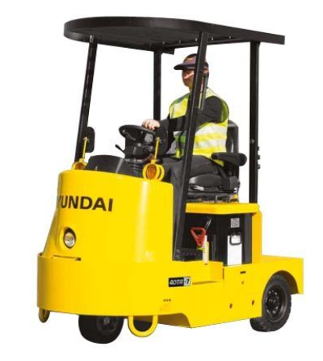
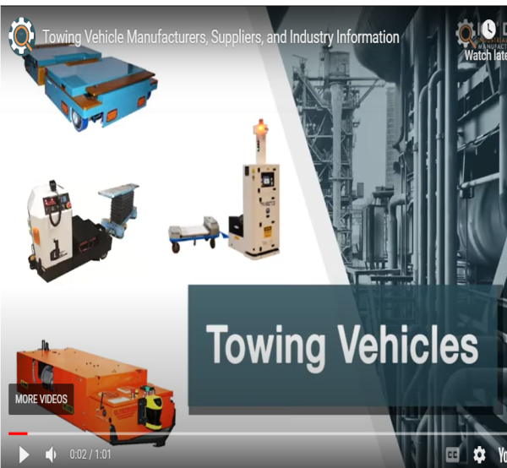
Types of AGVs
1. Towing vehicle –
It was the first type of AGVs to be introduced and still in use.
A common application is moving heavy payloads over large distances in warehouse or factories with or without intermediate pick up and drop off points along the route.
It’s an efficient type of transportation system.
Electronics and Communication Engineering – 20EC53I

Slide 6
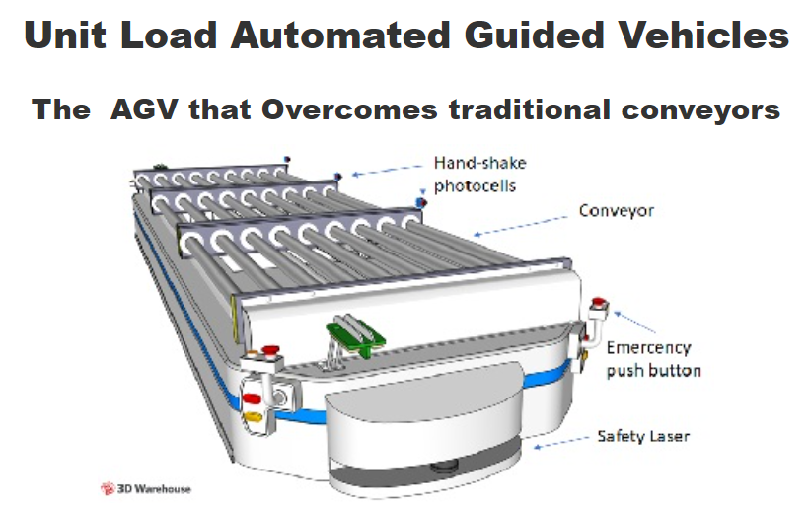
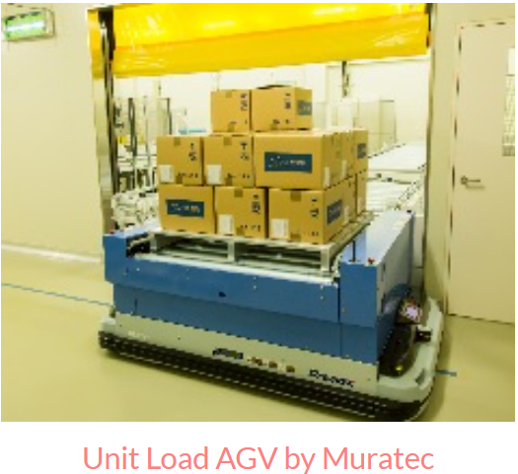
2. Unit load transporter-
These are used to move unit loads from one station to other. They often equipped for automatic loading and unloading of pallets, by means of powered rollers, belts etc.
Light load unit containers are relatively small vehicle with corresponding light load capacity (500lb or less).
An assembly line AGV is designed to carry a partially completed sub assembly through a sequence of assembly workstations to build the product.
Electronics and Communication Engineering – 20EC53I

Slide 7
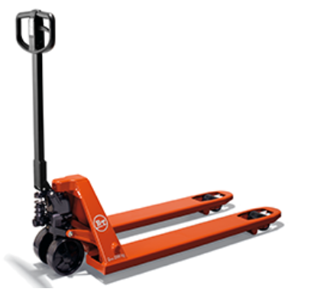
3. Pallet trucks-move palletized loads along predetermined routes
Electronics and Communication Engineering – 20EC53I

Slide 8
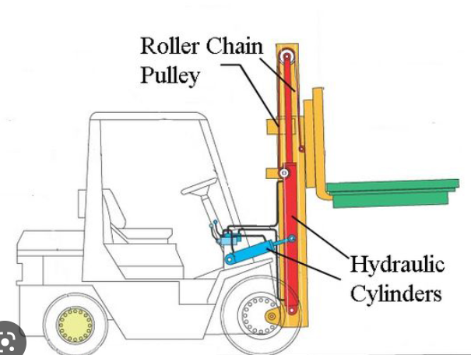
4. Forklift trucks –
Have ability to pick up and drop off palletized loads both at floor and on stands.
They can also stack loads in racks
Equipped with sensors so there is no need of human operator.
Expensive AGVs so they are applied only in the system where full automation is required.
Limited to palletized loads with ability to different height facilities.
Electronics and Communication Engineering – 20EC53I

Slide 9
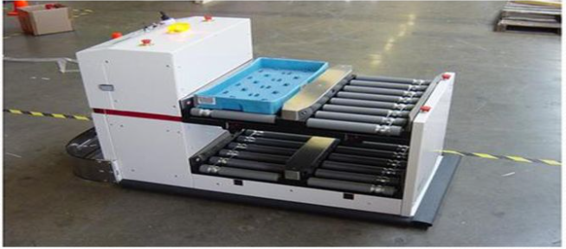
5. Light load transporter-
–
Capacity less than 500lb.
Used to handle small light parts over moderate distances.
Designed to operate within limited space
Electronics and Communication Engineering – 20EC53I

Slide 10
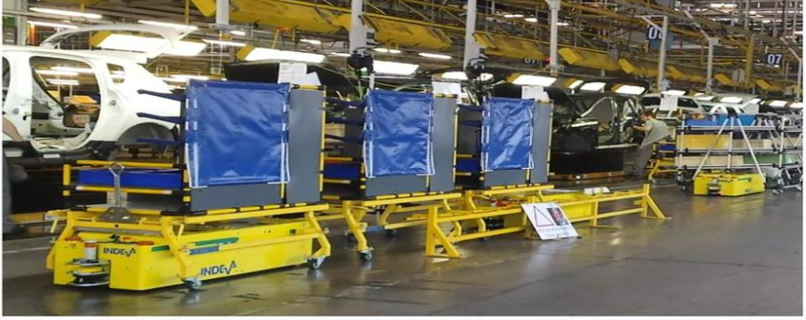
5. Assembly line vehicle-
Carries major subassemblies.
Provides manufacturing flexibility by permitting parallel operations in the manufacturing process.
Low expensive and easy to install
Variable speeds and dwell intervals can be programmed.
Speed is the range of 100 to 200 ft/min, capacity is 500 to 2000lb.
Electronics and Communication Engineering – 20EC53I

Slide 11
Video documentary of AGV
https://youtu.be/POpIAs9fKGw
Electronics and Communication Engineering – 20EC53I

Slide 12
Assessment Questions
1. What is the full form of AGV?
(a) Automatic gate valve
(b) Automated guided vehicles
(c) Automatic guided vehicle
(b) Automatic gated valve
Correct ans:
Automated guided vehicles
Electronics and Communication Engineering – 20EC53I

Slide 13
Assessment Questions
1. General purpose of Agv is?
(a) Used as rack
(b) Used for material handling
(c) Industrial general pirpose
(b) For pelletizing
Correct ans:
Used for material handling
Electronics and Communication Engineering – 20EC53I

Slide 14
Assessment Questions
2. Which type of AGV is used for heavy payloads?
(a) Towing vehicle
(b) Unit load transporter
(c) Pallet trucks
(b) Forklift trucks
Correct ans:
Towing vehicle
Electronics and Communication Engineering – 20EC53I

Slide 15
Assessment Questions
2. Light load transporter is used for capacity?
(a) <500lb
(b) >500lb
(c) 1000lb
(b) 2000lb
Correct ans:
<500lb
Electronics and Communication Engineering – 20EC53I

Slide 16
Assessment Questions
3. Components of Automation ?
(a) Sensors
(b) Actuators
(c) Controllers
(b) All the above
Electronics and Communication Engineering – 20EC53I

Slide 17
Assessment Questions
3. Components of Automation ?
(a) Sensors
(b) Actuators
(c) Controllers
(b) All the above
Electronics and Communication Engineering – 20EC53I

Slide 18
Assessment Questions
4. Sensors and Actuators are belongs to ?
(a) Supervisor Level
(b) Control Level
(c) Field Level
(b) Ground Level
Electronics and Communication Engineering – 20EC53I

Slide 19
Thank you
SMITHA SHENOY | 111, GOVT. POLYTECHNIC, CHANNAPATNA
PRAKASH | SUBJECT EXPERT
Dr. PANDURANGA H T | GOVT. POLYTECHNIC, BELUR
PREMAKUMARI P | 155, GOVT. POLYTECHNIC, TURUVEKERE
SHANKAR | GOVT. POLYTECHNIC, NAGAMANGALA
Electronics and Communication Engineering – 15EC52T

